Slide 1

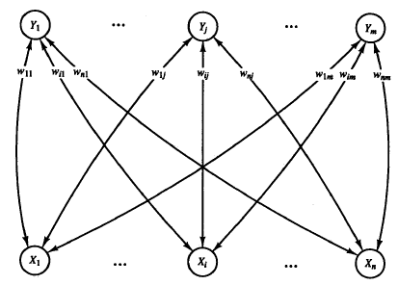






Bidirectional Associative Memory (BAM)
x₁
y₁
x_{i}
y_{j}
y_{m}
x_{n}
Repeat up to Stop Condition
This Network is a recurrent form of Hetro-Associative Network
At First, two disturbed and deformed patterns of s(p) and t(p) are assigned to “x” and “y” as two entrances of the network.
Using a bidirectional pattern association finally two input and output patterns converged to certain pair of patterns.
It is expected that s(p) and t(p) being final retrieved patterns. Other wise the network has failed to associate to the restored original patterns.

Slide 2
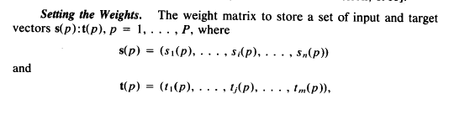
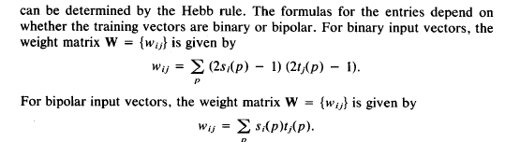

Setting the weights

Slide 3
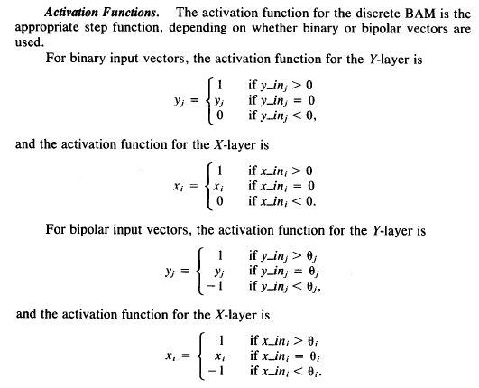

Activation Function

Slide 4
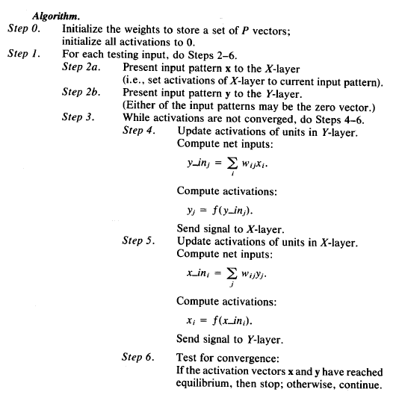

Algorithm

